Slide 1

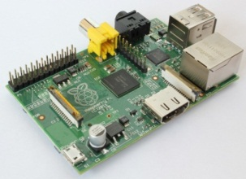
Introduction to Single-Board Computers and Microcontrollers
Or: The difference between
Arduino and Raspberry Pi
and alternatives

Slide 2


Single-Board Computer vs. Microcontroller
Raspberry Pi
Single-Board Computer
Arduino UNO
Microcontroller (MCU)

Slide 3
Outline
Introduction: Why they are popular
Characteristics
Two main skillsets required
Single-board computer vs microcontroller:
When to use which?
Different Types of Microcontrollers
Different Types of Single-board Computers

Slide 4
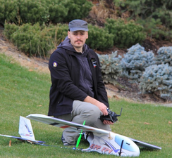
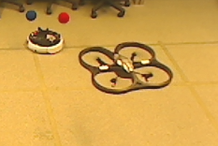
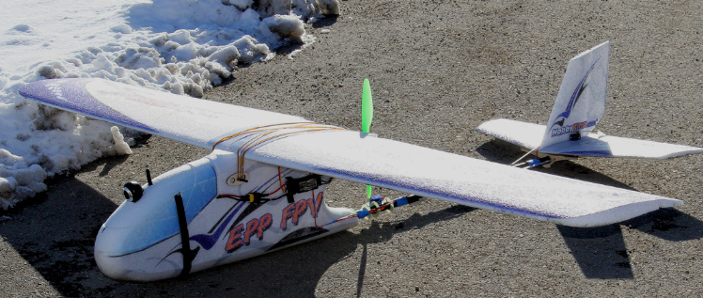
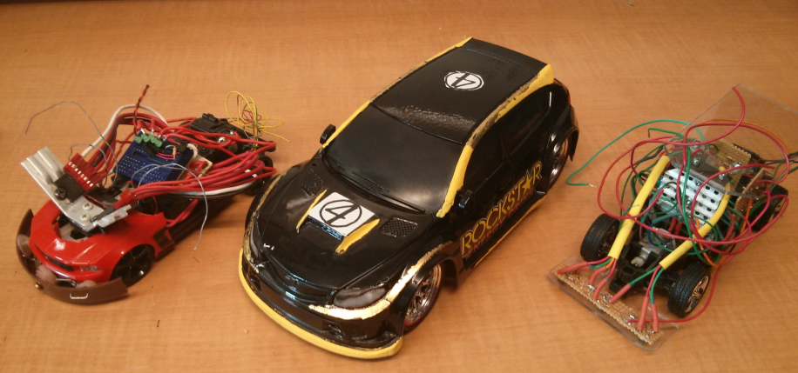

About Me
Vision-based robot control
UBCO Mechatronics Club
Time-Lapse Photography

Slide 5
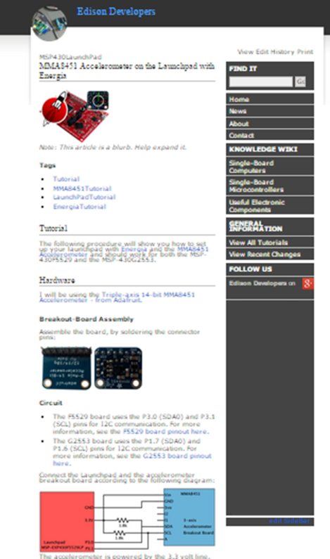
My Knowledge about Arduino/RPi
http://edisondev.net/
Tutorials and information about single-board computers and microcontrollers
“Late”st News

Slide 6
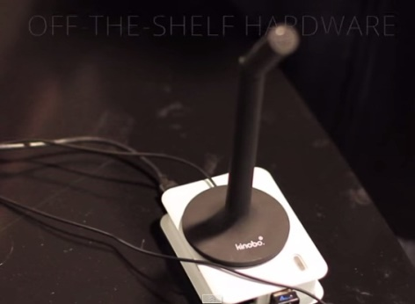
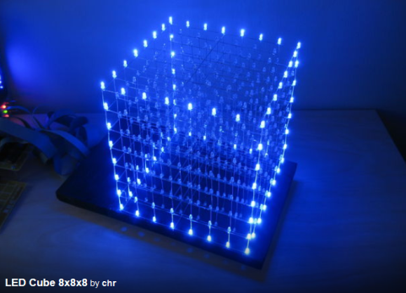
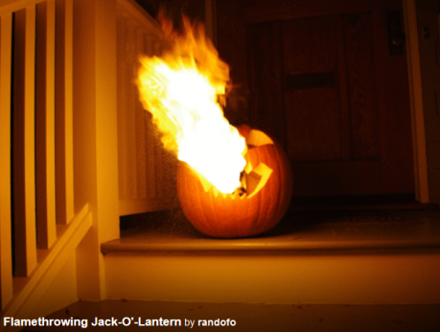
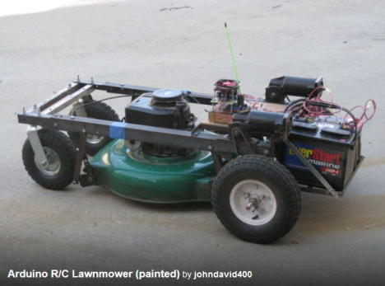
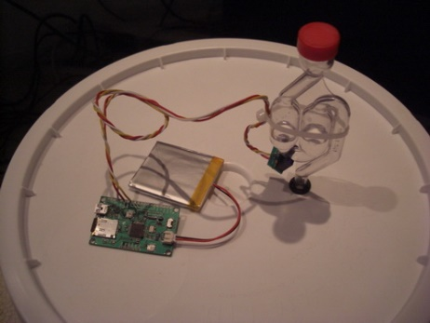
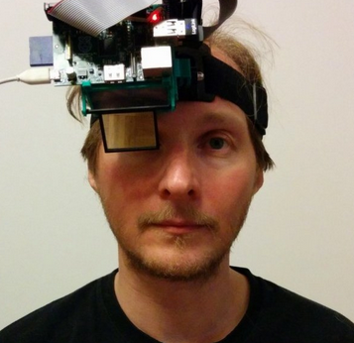
What can you do with Arduinos or Raspberry Pis?
Jasper – Voice Controller powered by Rpi https://jasperproject.github.io
LED Cube - http://www.instructables.com/id/Led-Cube-8x8x8/
Flamethrower Jack-O-Lantern - http://www.instructables.com/id/Flamethrowing-Jack-O-Lantern/
Arduino RC- Lawnmower http://www.instructables.com/id/Arduino-RC-Lawnmower/
Fermentation Monitoring - https://www.sparkfun.com/tutorials/131
Raspberry Eye - https://hackaday.io/project/865-raspberry-eye

Slide 7
Why are they so popular?
They are cheap
They sense and manipulate the physical world
GPIO pins (reading values/sending instructions)

Slide 8
Internet of Things (IoT)
Connection of embedded computing devices to the internet
Home Automation
Augmented Reality
Connecting non-computer devices
Aquariums
Home Entertainment
Etc.

Slide 9
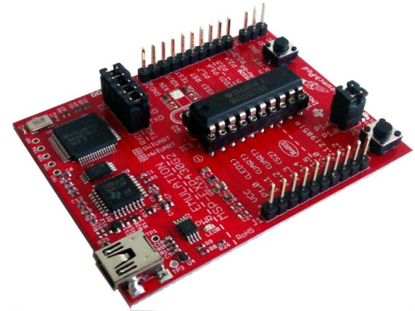
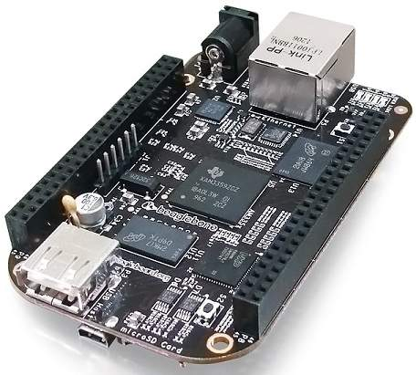
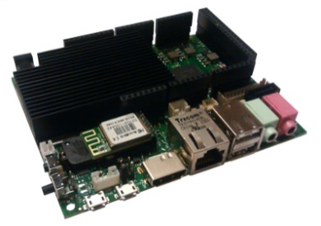
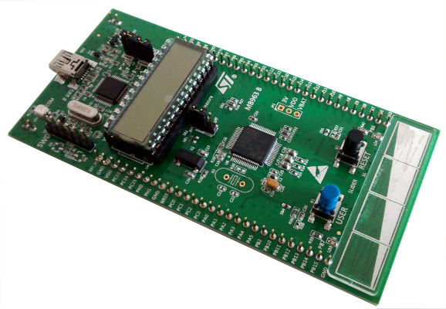
Single-Board Computer vs. Microcontroller What is the difference?
Single-board Computers
Microcontrollers

Slide 10
Single-Board Computer vs. Microcontroller What is needed for a Computer/Microcontroller?
Storage
RAM
Processor
Notes:
Processor: Executes instructions

Slide 11


Single-Board Computer vs. Microcontroller Rough Specifications
 | Microcontrollers | Single-Board Computers
Processor Speed | ~50 Mhz | 1 Ghz +
Onboard Storage | 64 Kb | Flash, SD cards ~Gb
Memory (RAM) | 64 Kb | ~ 1 Gb
Power Consumption | 12 mA (2200 mAh battery -> 183hr) | 500 mA+ (2200 mAh battery-> 4.4 hr)
Reboot Time | <1 sec | ~ Multiple seconds
Other Features |  | Operating system Extendable Storage Network Connection

Slide 12
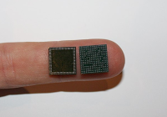
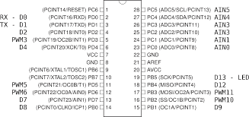
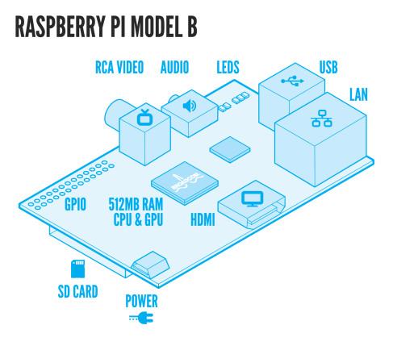
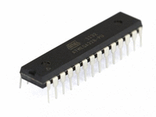
Single-Board Computer vs. Microcontroller Examples of Embedded Systems
Broadcom BCM2835
CPU, GPU, RAM
Storage
ATMega328
CPU, RAM, Storage
Image Source
http://pixshark.com/raspberry-pi-model-b-schematic.htm
http://images.studica.com/images/product/arduino/9a9b5c9e479e1a5b237b41a173d34dcfimage472x354_72_200x.gif

Slide 13
Single-Board Computer vs. Microcontroller Defining Features
Single-board computer
Lots of processing power
Has operating system (Linux, Android, soon Windows)
Monitor Connection
Cheap, “weak” computer
Microcontroller
Devoted to having GPIO pins
Low power, quick boot
Very cheap (especially if you buy only IC)

Slide 14
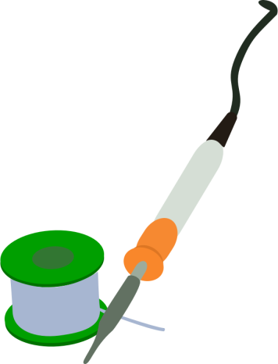

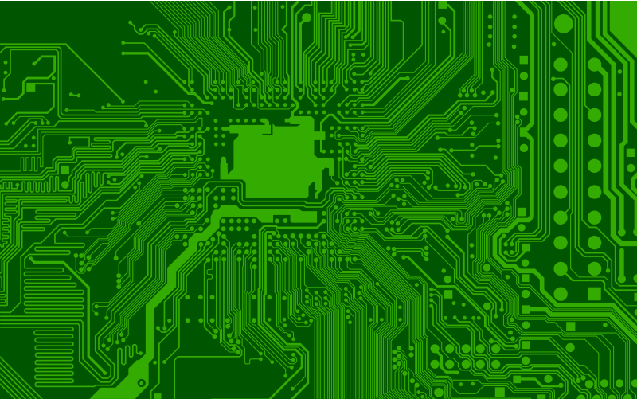
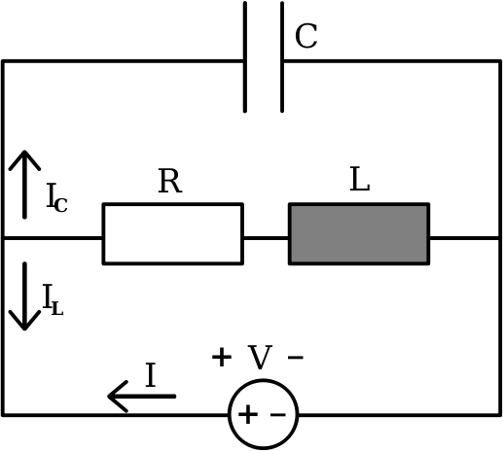
Challenges for Beginners
Working with these devices boils down to:
Programming
Electronics Knowledge
Image Source: https://openclipart.org/

Slide 15
First Challenge Programming
Loads of Examples from Community
With little skill you can program an Arduino to do simple things
But how do you write a program to control a robot arm?
Mathematics
Kinematics
And other things you learn in school
Need knowledge from diverse fields
Notes:
Population is becoming more digitally literate

Slide 16
First Challenge Programming – Simplifying Aspects
Pre-written Libraries
Code Examples
https://github.com/
Community help (Forums, StackExchange)
Free online courses
Search for “MIT Arduino Course”
Programming courses on:
Khan Academy
Coursera
Udacity

Slide 17
Second Challenge Electronics – the hard part
Difficult to get started
Easy to make mistakes
Some mistakes cannot be undone
Often needs additional equipment:
Soldering Iron
Voltmeter
Oscilloscope

Slide 18
Electronics Simplifying Aspects
Starter Packs and Kits
Contain a minimum number of electronic components that you may need
Microcontroller Attachments
Shields (for Arduino)
Motor shields, sensor shields
Capes (for Beagleboard)
BoosterPacks (TI LaunchPad)
Notes:
-Simplify things for beginners and prototyping
-Somewhat pricey
-You would not use it for the final product, because it has components that you don’t need

Slide 19
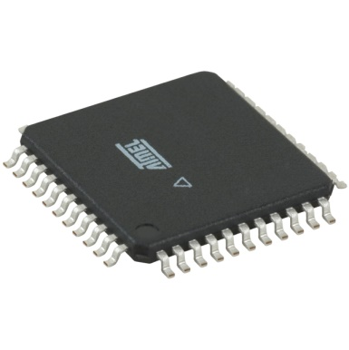
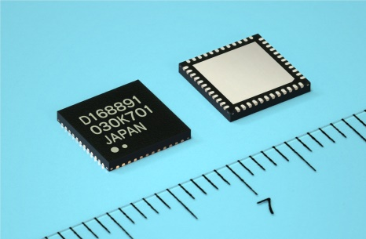
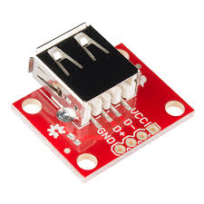
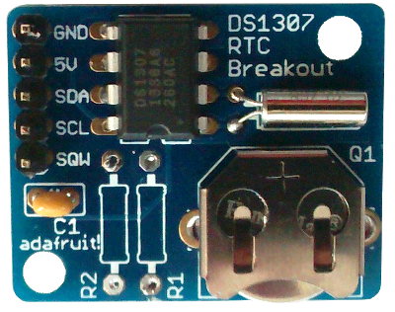
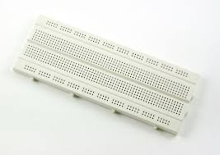
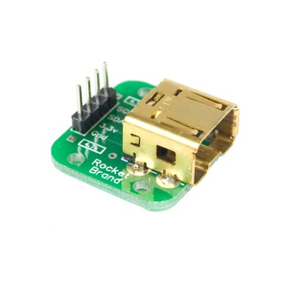
Electronics Simplifying Aspects
A lot of electronics come like this:
Solution: Breakout boards: pre-soldered breadboard-ready electronics:
Source:
http://elecshop.blog.com/files/2014/01/313-44-TQFP.jpg
http://www.renesas.com/media/press/news/2010/20101006.jpg

Slide 20
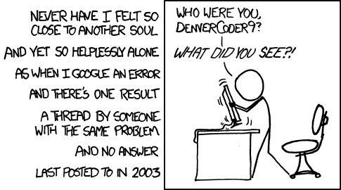
Electronics Simplifying Aspects
Community
People who know things and are willing to share
Accessible tutorials
http://xkcd.com/979/
Notes:
-Simplify things for beginners and prototyping
-Somewhat pricey
-You would not use it for the final product, because it has components that you don’t need

Slide 21
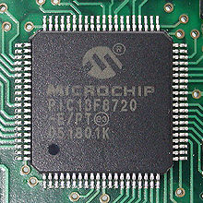
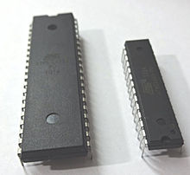
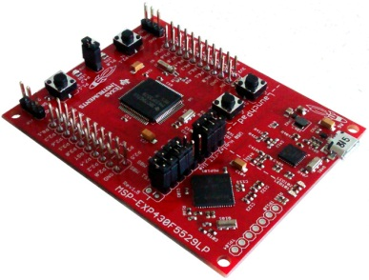

Microcontroller Microcontroller vs. Expansion Boards
Microcontrollers:
Expansion Board:
Image Source: http://en.wikipedia.org/wiki/Microcontroller

Slide 22
Microcontroller Microcontrollers Features
Processor Speed (Mhz)
RAM
On-board storage (FLASH)
GPIO Pins
Analog to Digital Converters (ADC)
Logic Level Voltage (3.3V or 5V)

Slide 23
Microcontroller Expansion Board Features
Communication Cable Attachments
Programmer
Buttons
Power Supply Connectors
Pin connectors
On-board Sensors
(accelerometers, real-time clocks, temperature sensors)

Slide 24
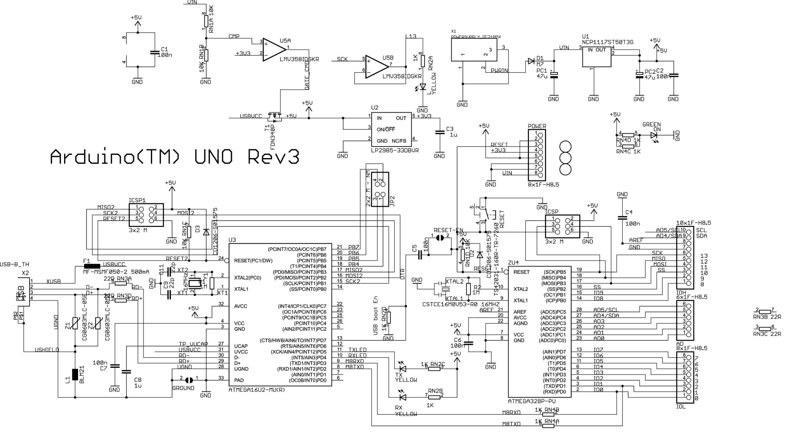
Microcontroller Arduino UNO Board Diagram
USB Interface + Programmer
Arduino ATMEGA328P
Source: http://arduino-info.wikispaces.com/file/view/Arduino_Uno_Rev3-schematic.jpg/346644662/Arduino_Uno_Rev3-schematic.jpg

Slide 25

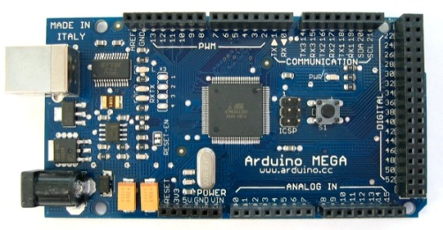
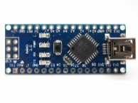
Microcontrollers Arduino
 | Arduino Uno | Arduino Mega2560 | Arduino Nano (ATmega328)
Microcontroller | ATmega328 | ATmega2560 | ATmega328
Flash Memory | 32KB | 256KB | 32KB
Clock Speed | 16MHz | 16MHz | 16 MHz
RAM | 2KB | 8KB | 1KB
Price (approx, USD) | $24.95here | $45.95 here | $34.99 here
Digital I/O Pins | 14 | 54 | 14
http://arduino.cc/

Slide 26
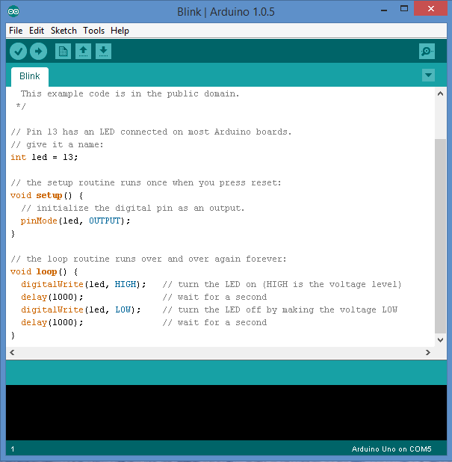
Microcontrollers Arduino IDE - Programming
http://arduino.cc/

Slide 27
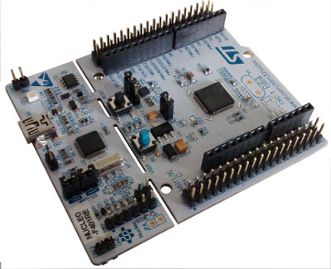
Microcontrollers STM Microcontrollers
 | STM32L DISCOVERY | STM32 Nucleo F401RE
Microcontroller | STM32L152RBT6 Cortex-M3 CPU | STM32F401RET6
Flash Memory | 128KB | 2 MB
Clock Speed | 32 Mhz | 180 Mhz
RAM | 16KB | 256 KB
Price (approx, USD) | $10.50 here | $12.40 here
Other | 1 touch sensor 1 LCD display
http://www.st.com/web/catalog/tools/PF250990

Slide 28

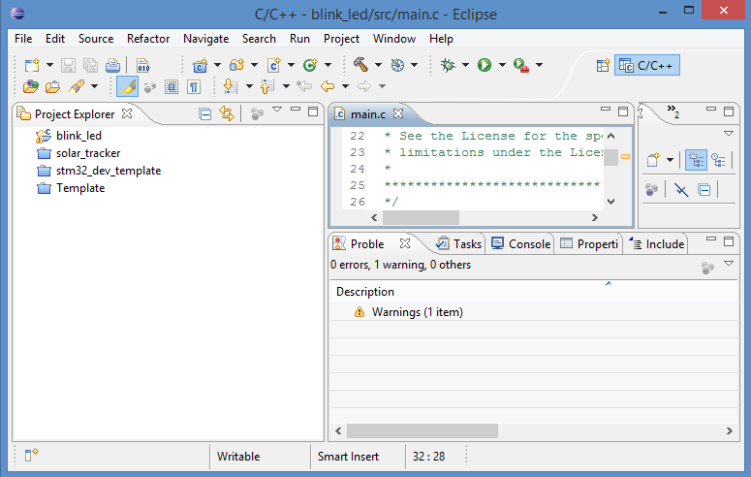
Programming Any Microcontroller
Eclipse https://eclipse.org/

Slide 29

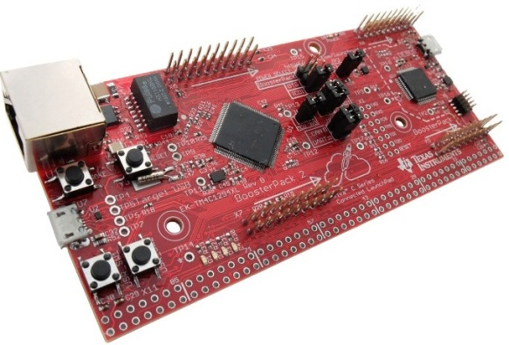

Microcontrollers Texas Instruments LaunchPad
 | MSP-EXP430G2 | MSP430F5529 | Tiva C Series TMC4C1294
Microcontroller | MSP430 | MSP430 | TM4C1294NCPDT ARM Cortex-M4
Flash Memory | 16 KB | 128KB | 1 MB
Clock Speed | 16 Mhz | 25 MHz | 120 Mhz
RAM | 512B | 8KB | 256 KB
Price (approx, USD) | $9.99 here | $12.99 here | $19.99 here
Other |  |  | Ethernet
http://www.ti.com/ww/en/launchpad/launchpad.html

Slide 30
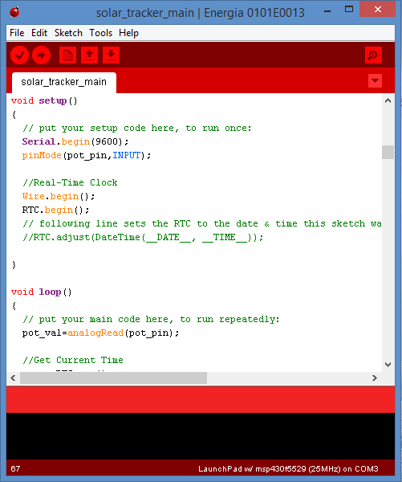
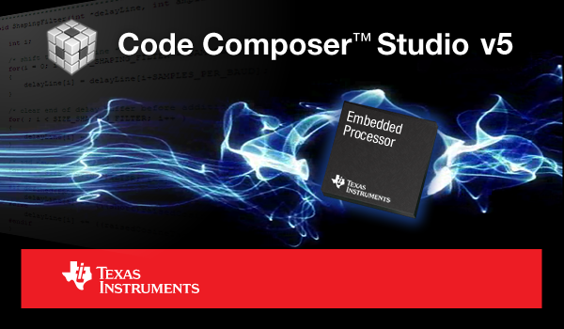
Microcontrollers LaunchPad Programming
Energia
http://energia.nu/
Code Composer Studio

Slide 31
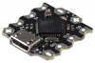
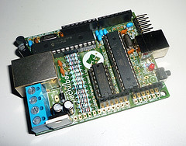
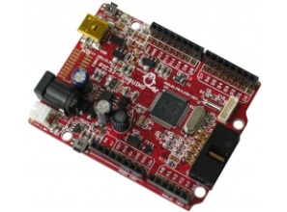
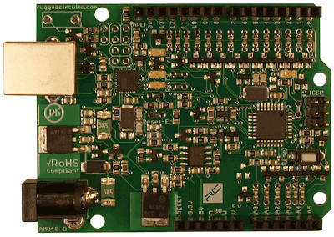
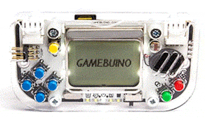
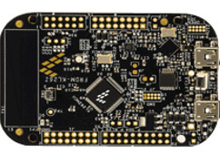
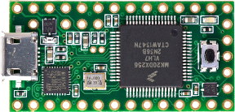
Microcontrollers Thousands Others
Some of these had limited production runs or have been discontinued.
Beetle
Nanode
Pinguino PIC32
Ruggeduino
Freescale Freedom
Teensy
Gamebuino
Beetle: http://www.dfrobot.com/wiki/index.php/Beetle_SKU:DFR0282
Nanode: http://www.nanode.eu/
Pinguino PIC32: https://www.olimex.com/Products/Duino/PIC32/PIC32-PINGUINO/open-source-hardware
Ruggeduino: http://www.ruggedcircuits.com/ruggeduino/
Gamebuino: http://gamebuino.com/
Freescale Freedom: http://www.freescale.com/webapp/sps/site/overview.jsp?code=FREDEVPLA
Teensy: https://www.pjrc.com/teensy/

Slide 32
Single-Board Computers
Properties
Processor Speed (Ghz, Multiple core)
RAM (speed of RAM)
Video Card (Home entertainment)
On-board storage (FLASH)
Hard-drive storage
GPIO pins
Features
Audio jack
IR remote
Blue tooth
Other connectors

Slide 33
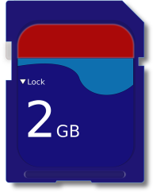







Single-Board Computers Hidden Costs
Minimum:
Other Requirements:
SD card
Ethernet Connection
USB Power
HDMI connection + Monitor
Keyboard + Mouse +
USB Hub (sometimes)

Slide 34


Single-Board Computers Raspberry Pi
 | Raspberry Pi Model B | Raspberry Pi 2
Processor | ARM1176JZF-S core | Quad-core ARM7
Flash Memory | None | None
Clock Speed | 700 MHz | 800 MHz
RAM | 512MB | 1 GB
Price (approx, USD) | $39.95 | $35.00
Other Features | 2x USB ports 26x GPIO pins | 4x USB2.0 40x GPIO pins
http://www.raspberrypi.org/
Image Source: http://www.techradar.com/news/computing-components/peripherals/raspberry-pi-2-outed-with-faster-cpu-double-ram-and-windows-10-support-1283075

Slide 35
Single-Board Computers Beaglebone Black
 | Beaglebone Black
Processor | 1GHZ
Flash Memory | 2GB 8-bit eMMC on-board storage
RAM | 512MB DDR3
Other Features | Open Hardware Architecture 1x USB port 92x GPIO pins
Price (approx, USD) | $45.00
http://beagleboard.org/

Slide 36

Single board Computers Banana Pi
 | Banana Pi
Processor | 1 GHz dual core
Flash Memory | None
RAM | 1GB DD3
Other Features | SATA Connection Audio Connector 2x USB
Price (approx, USD) | $60
http://www.bananapi.org/

Slide 37

Single board Computers ODROID-C1
 | ODROID-C1
Processor | 1.5GHz quad core
Flash Memory | slot for expansion
RAM | 1GB DD3
Other Features | Infrared (IR) receiver 4x USB
Price (approx, USD) | $36.95
http://www.hardkernel.com

Slide 38

Single-Board Computers UDOO
 | UDOO Quad
Processor | Quad-core 1GHz
Flash Memory | None (SATA connector)
RAM | 1 GB DDR3
Other Features | 2x USB port WiFi Module 76 x GPIO pins Analog Audio and Mic
Price (approx, USD) | $135.00
http://www.udoo.org/

Slide 39

Single board Computers Firefly-RK3288
 | Firefly-RK3288
Processor | 1.8GHz quad core
Flash Memory | 16 GB
RAM | 2 GB DD3
Other Features | Infrared (IR) receiver VGA adapter 2x USB
Price (approx, USD) | $189
http://www.t-firefly.com/en/

Slide 40
Conclusion
Community is Key
If you learn something, share.
Don’t just stick to the “popular” devices.
For low power requirements, simple tasks, use microcontroller.

